Slide 1

Angular Training {
intermediate.html
workshop.css
[Intermediate Workshop]
< Prepared by: Charles Adison >
}
Angular Training Intermediate

Slide 2
Table Of Contents {
01
02
03
intermediate.html
workshop.css
Routing and Navigation
< How to switch between pages? >
Services and API requests
< Consume data from the server >
Observables and RxJS
< Reactive Programming >
}
Angular Training Intermediate

Slide 3
Table Of Contents {
intermediate.html
workshop.css
04
Store-service Design
< State based design pattern >
05
Error Handling and Debugging
< Handle unexpected exception, etc >
}
Angular Training Intermediate

Slide 4
01 {
[Routing and Navigation]
intermediate.html
workshop.css
< How to switch between pages? >
}
Angular Training - Routing and Navigation

Slide 5
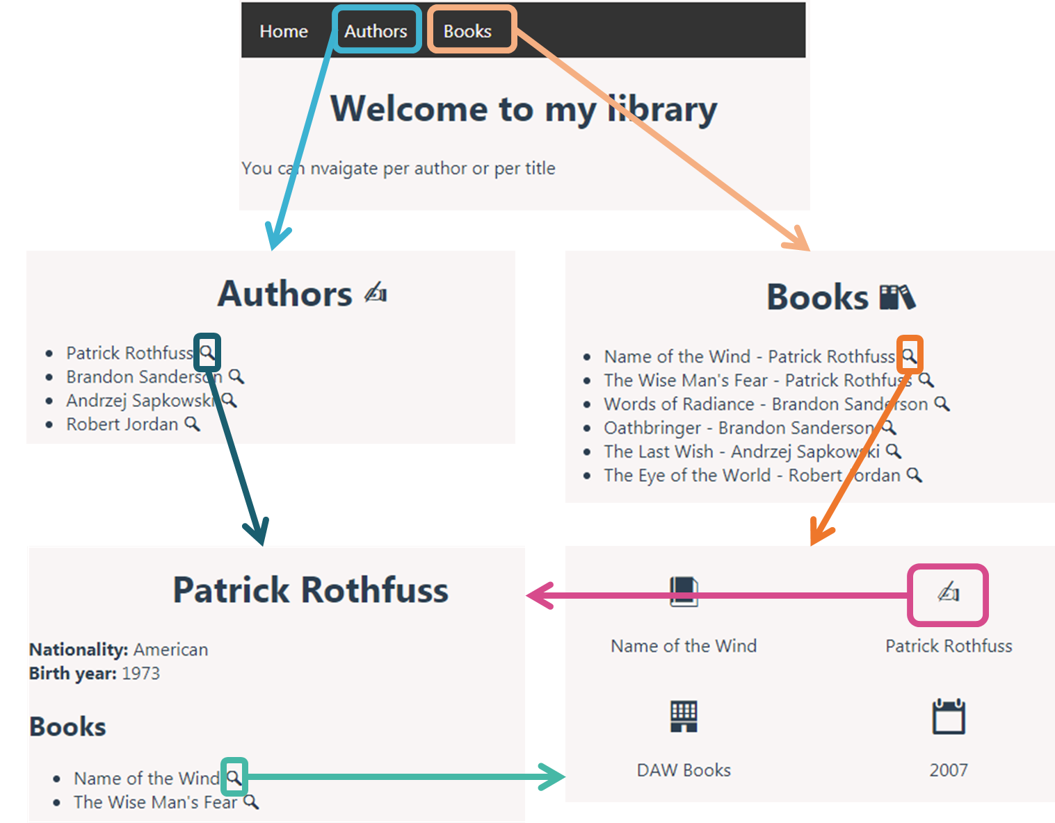
Angular Routing {
intermediate.html
workshop.css
}
Angular Training - Routing and Navigation

Slide 6
Angular Routing {
intermediate.html
workshop.css
* As an SPA app, the server always serves a single HTML page, and navigation between the application pages/sections is managed on the client side in JavaScript
* This approach allows smoother transitions between pages, and reduces the number of server calls needed to navigate between pages, improving the UX
* Angular team provides a library for this purpose: @angular/router
}
Angular Training - Routing and Navigation

Slide 7
Routing Module {
intermediate.html
workshop.css
import { NgModule } from '@angular/core';
import { RouterModule, Routes } from '@angular/router';
const routes: Routes = [];
@NgModule({
imports: [RouterModule.forRoot(routes)],
exports: [RouterModule]
})
export class AppRoutingModule { }
}
Angular Training - Routing and Navigation

Slide 8
Routing Module {
intermediate.html
workshop.css
const routes: Routes = [
{ path: 'registration', component: RegistrationComponent },
{ path: 'forgotten-password', component: ForgottenPasswordComponent },
{ path: 'login', component: LoginComponent },
{ path: 'dashboard', component: DashboardComponent, canActivate: [AuthenticationGuard] },
{ path: '', pathMatch: 'full', redirectTo: '/dashboard' },
{ path: '**', redirectTo: '/dashboard' }
]
}
Angular Training - Routing and Navigation

Slide 9
Routing Module {
intermediate.html
workshop.css
* canActivate allows you to define route guards. A route guard blocks the activation of the route if the condition it defines is not verified
* pathMatch: 'full' forces the path to be matched against the entire URL.
* '**': is a wildcard which means it matches any URL
}
Angular Training - Routing and Navigation

Slide 10
router-outlet {
intermediate.html
workshop.css
* The NavbarComponent should remain displayed at all times which means that components should be inserted under it. Let's add the router-outlet in the AppComponent
<app-navbar></app-navbar>
<router-outlet></router-outlet>
}
Angular Training - Routing and Navigation

Slide 11
routerLink {
intermediate.html
workshop.css
<nav>
<ul>
<li><a routerLink='/home'>Home</a></li>
<li><a routerLink='/authors'>Authors</a></li>
<li><a routerLink='/books'>Books</a></li>
</ul>
</nav>
}
Angular Training - Routing and Navigation

Slide 12
routerLink {
intermediate.html
workshop.css
WARNING:
Usually a link destination is specified via the href attribute.
However, this is not the way to go for navigation within an SPA and should only be used for navigation to external URLs.
Indeed, navigating via href in an SPA makes the entire app reload which is highly inefficient and offers very poor user experience.
}
Angular Training - Routing and Navigation

Slide 13
routerLinkActive {
intermediate.html
workshop.css
<nav>
<ul>
<li><a routerLinkActive="active" routerLink="/home">Home</a></li>
<li><a routerLinkActive="active" routerLink="/authors">Authors</a></li>
<li><a routerLinkActive="active" routerLink="/books">Books</a></li>
</ul>
</nav>
}
Angular Training - Routing and Navigation

Slide 14
ActivatedRoute service {
intermediate.html
workshop.css
< Through it, the component associated with the current route can extract information from the URL via the paramMap and queryParamMap properties >
export class ExampleComponent implements OnInit {
constructor(private route: ActivatedRoute) {}
ngOnInit(): void {
const id: string = this.route.snapshot.paramMap.get('id')
}
}
}
Angular Training - Routing and Navigation

Slide 15
Router service {
intermediate.html
workshop.css
< Sometimes, it is necessary to trigger some actions before routing. This is what happens when we click on a login button for example. >
export class ExampleComponent {
constructor(private router: Router) {}
navigatePostLogin(): void {
this.router.navigateByUrl('/dashboard')
}
}
}
Angular Training - Routing and Navigation

Slide 16
02 {
[Services and API requests]
intermediate.html
workshop.css
< Consume data from the server >
}
Angular Training - Services and API requests

Slide 17
Angular Services {
intermediate.html
workshop.css
< Along with components and directives, services are one of the main building blocks of an Angular application. >
ng generate service services/example import { Injectable } from '@angular/core'
@Injectable({
providedIn: 'root'
})
export class ExampleService {
}
}
Angular Training - Services and API requests

Slide 18
Angular Services {
intermediate.html
workshop.css
import { Component } from '@angular/core'
import { ExampleService } from '@services/example.service'
@Component({
selector: 'app-example',
templateUrl: './example.component.html'
})
export class ExampleComponent {
constructor(
private exampleService: ExampleService
) {}
}
}
Angular Training - Services and API requests

Slide 19
Passing Data / Shared function {
intermediate.html
workshop.css
< Services can also be used to pass data or share functions across components >
}
Angular Training - Services and API requests

Slide 20
Dependency Injection {
intermediate.html
workshop.css
Dependencies can be provided at three levels:
* root level: this is the default behaviour when creating a service with the CLI. That is what providedIn: 'root' means. The same instance of the dependency is injected everywhere it is needed as if it were a singleton.
* module level: the dependency is added to the providers array of the NgModule. The module gets its own instance of the dependency
* component level: the dependency is added to the providers array of the component. Each instance of that component gets its own instance of the dependency.
}
Angular Training - Services and API requests

Slide 21
03 {
[Observables and RxJS]
intermediate.html
workshop.css
< Reactive Programming >
}
Angular Training - Observables and RxJS

Slide 22
RxJS {
intermediate.html
workshop.css
* RxJS is a library for reactive programming using Observables. It makes it easier to compose asynchronous or callback-based code.
* It frees you from tangled webs of callbacks, and thereby makes your code more readable and less prone to bugs.
}
Angular Training - Observables and RxJS
Notes:
Baeldung
Reactive programming is a declarative programming paradigm that is based on the idea of asynchronous event processing and data streams
Wikipedia
In computing, reactive programming is a declarative programming paradigm concerned with data streams and the propagation of change.

Slide 23
Observables {
intermediate.html
workshop.css
* Observables are returned by the HttpClient service methods.
* Observables are only executed once subscribed to
* The subscribe method takes one object with three callbacks (next, error and complete) as a parameter
}
Angular Training - Observables and RxJS
Notes:
Baeldung
Reactive programming is a declarative programming paradigm that is based on the idea of asynchronous event processing and data streams
Wikipedia
In computing, reactive programming is a declarative programming paradigm concerned with data streams and the propagation of change.
{
path: 'rxjs-demo',
component: RxjsDemoComponent,
},
{
path: '**',
redirectTo: '/rxjs-demo',
pathMatch: 'full',
},

Slide 24
Observable Creation {
intermediate.html
workshop.css
* In an Angular app, you will rarely have to create observables yourself. Most of the time you will handle streams that the framework created for you such as handling http call results
* However, you may encounter situations where it may fall on you to create a stream.
}
Angular Training - Observables and RxJS
Notes:
Baeldung
Reactive programming is a declarative programming paradigm that is based on the idea of asynchronous event processing and data streams
Wikipedia
In computing, reactive programming is a declarative programming paradigm concerned with data streams and the propagation of change.
{
path: 'rxjs-demo',
component: RxjsDemoComponent,
},
{
path: '**',
redirectTo: '/rxjs-demo',
pathMatch: 'full',
},

Slide 25
interval operator {
intermediate.html
workshop.css
interval(1000).subscribe({
next: (n) => {
console.log(`It's been ${n + 1} seconds since subscribing!`);
},
});
}
Angular Training - Observables and RxJS
Notes:
Baeldung
Reactive programming is a declarative programming paradigm that is based on the idea of asynchronous event processing and data streams
Wikipedia
In computing, reactive programming is a declarative programming paradigm concerned with data streams and the propagation of change.
{
path: 'rxjs-demo',
component: RxjsDemoComponent,
},
{
path: '**',
redirectTo: '/rxjs-demo',
pathMatch: 'full',
},

Slide 26
promise transformation {
intermediate.html
workshop.css
const promise1 = new Promise((resolve, reject) => {
setTimeout(() => {
resolve('foo');
}, 2000);
});
from(promise1).subscribe({
next: (message) => console.log(`The delayed message is '${message}'`),
error: (error) => console.log("There's been an error"),
complete: () => console.log('Completed'),
});
}
Angular Training - Observables and RxJS
Notes:
Baeldung
Reactive programming is a declarative programming paradigm that is based on the idea of asynchronous event processing and data streams
Wikipedia
In computing, reactive programming is a declarative programming paradigm concerned with data streams and the propagation of change.
{
path: 'rxjs-demo',
component: RxjsDemoComponent,
},
{
path: '**',
redirectTo: '/rxjs-demo',
pathMatch: 'full',
},

Slide 27
browser event transformation {
intermediate.html
workshop.css
fromEvent(document, 'click').subscribe({
next: (_) => console.log('Clicked!'),
});
}
Angular Training - Observables and RxJS
Notes:
Baeldung
Reactive programming is a declarative programming paradigm that is based on the idea of asynchronous event processing and data streams
Wikipedia
In computing, reactive programming is a declarative programming paradigm concerned with data streams and the propagation of change.
{
path: 'rxjs-demo',
component: RxjsDemoComponent,
},
{
path: '**',
redirectTo: '/rxjs-demo',
pathMatch: 'full',
},

Slide 28
pipe function {
intermediate.html
workshop.css
* pipe() is a function used to compose operators such as map(), filter(), take()...
* Operators are applied to the stream in the order they are passed to the pipe function
}
Angular Training - Observables and RxJS

Slide 29
map operator {
intermediate.html
workshop.css
fromEvent(document, 'click')
.pipe(
map(
(event) =>
`x: ${(event as MouseEvent).clientX}, y: ${
(event as MouseEvent).clientY
}`
)
)
.subscribe({ next: (data) => (this.coordinates = data) });
}
Angular Training - Observables and RxJS

Slide 30
filter operator {
intermediate.html
workshop.css
from([1, 2, 3, 4, 5, 6, 7, 8])
.pipe(filter((data) => data % 2 === 0))
.subscribe({ next: (data) => console.log(data) });
}
Angular Training - Observables and RxJS

Slide 31
Error handling {
intermediate.html
workshop.css
this.userService.getUsers().subscribe({
next: (users) => console.log(`The following users exist in the system: ${users}`),
error: (error) => console.log(`An error occurred: ${error}`),
complete: () => console.log('Completed'),
});
}
Angular Training - Observables and RxJS

Slide 32
catchError operator {
intermediate.html
workshop.css
this.userService
.getUsers()
.pipe(
catchError((error) => {
if ((error as HttpErrorResponse).status === 404) {
return of([]);
}
return throwError(error);
})
)
.subscribe({
next: (users) =>
console.log(`The following users exist in the system: ${users}`),
error: (error) => console.log(`An error occurred: ${error}`),
complete: () => console.log('Completed'),
});
}
Angular Training - Observables and RxJS

Slide 33
RxJS Guide {
intermediate.html
workshop.css
< Other most used RxJS operators: take, takeUntil, concatMap, forkJoin >
* https://rxjs.dev/guide
* https://rxmarbles.com/
}
Angular Training - Observables and RxJS

Slide 34
Observable reminders {
intermediate.html
workshop.css
< A very common pitfall with RxJS is to nest subscribes. RxJS provides plenty of operators so that you won't ever have to mix synchronous and asynchronous code. Why shouldn't you mix them ? >
* it is spaghetti code that becomes hard to read and maintain as it doesn't benefit from the declarativeness of RxJS anymore
* it causes memory leaks
}
Angular Training - Observables and RxJS

Slide 35
Unsubscribing observables {
intermediate.html
workshop.css
< For the moment we've seen how to subscribe to Observables. To avoid memory leaks with long-lived Observables, you should unsubscribe from them. >
* it is spaghetti code that becomes hard to read and maintain as it doesn't benefit from the declarativeness of RxJS anymore
* it causes memory leaks (demo BookDetails)
}
Angular Training - Observables and RxJS

Slide 36
When to Unsubscribe {
intermediate.html
workshop.css
< If you have no certainty the Observable will complete or error out, you should manually unsubscribe from it. The HttpClient always completes the Observable it returns after having received a response. Below are 2 ways to unsubscribe. >
* The subscribe method returns a Subscription object that can be disposed of by calling the unsubscribe method on it when desired, usually when the component it lives in is destroyed
* Using the takeUntil operator and a Subject which is a special kind of Observable on which it is possible to call the next(), error() and complete() methods - demo fixed memory leak (BookDetails)
}
Angular Training - Observables and RxJS

Slide 37
04 {
[RxJS Subjects]
intermediate.html
workshop.css
< Advanced data sharing concept >
}
Angular Training - RxJS Subjects

Slide 38
RxJS Subjects {
intermediate.html
workshop.css
* A Subject is a special kind of Observable from the RxJS library which allows us to multicast values to the components which have subscribed to it
* Whenever Subject emits a value, each of its subscribers gets notified about the emitted value
}
Angular Training - RxJS Subjects

Slide 39
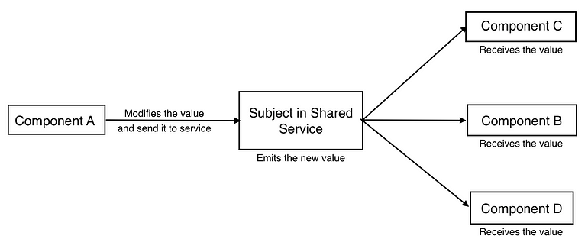
RxJS Subjects {
intermediate.html
workshop.css
}
Angular Training - RxJS Subjects

Slide 40
BehaviorSubjects {
intermediate.html
workshop.css
* BehaviorSubject is basically the same with Subject except it must have initial value.
import { BehaviorSubject } from 'rxjs';
const subject = new BehaviorSubject(inital_value);
}
Angular Training - RxJS Subjects

Slide 41
ReplaySubjects {
intermediate.html
workshop.css
* ReplaySubject can emit multiple old values to new subscribers. While creating the ReplaySubject, you have to specify, how many old values you want to store and for how long you want to keep them.
import { ReplaySubject } from 'rxjs';
const subject = new ReplaySubject(No_of_values, Time);
}
Angular Training - RxJS Subjects

Slide 42
05 {
[Error Handling and Debugging]
intermediate.html
workshop.css
< Handle unexpected exception, etc. >
}
Angular Training - Error Handling and Debugging

Slide 43
Error Types {
intermediate.html
workshop.css
* HTTP Errors are thrown, when you send a HTTP Request using the HttpClient Module – handled by HTTP Interceptors
* Client Side Errors all other errors thrown by the code falls into this category – handled by ErrorHandler
}
Angular Training - Error Handling and Debugging

Slide 44
Debugging Tips {
intermediate.html
workshop.css
* debugger keyword
* Angular DevTools extension
}
Angular Training - Error Handling and Debugging

Slide 45
Thanks; {
forbeginners.html
workshop.css
‘Do you have any questions?’
charles.adison1@lexisnexisrisk.com
< Please keep this slide for attribution >
}
Angular Training Intermediate - End

Slide 46


